Slide 1
3. Data Access
ADVANCED
OPERATIONS
TRAINING
© Copyright Scality 2022
RING 8.5

Slide 2
Data Access
At the end of this module, you will be able to …
… provide data access to end users and applications
… and also test the service.
Notes:
Last update: 20180410

Slide 3
Contents
SOFS Volume Management
NFS
NFS Export Management
NFS Client Access Example
SMB
SMB Share Management
SMB Client Access Example
CDMI
CDMI Interface Management
CDMI Client Access Example
LocalFS
LocalFS Data Access Mgt
LocalFS Client Access Example
S3 Connector
S3C Data Access Management
S3C Client Access Example
XDM/Zenko
XDM Data Access Management
XDM Client Access Example
REST (sproxyd)
REST Data Access Management
REST Client Access Example
RS2 Light
RS2 Data Access Management
RS2 Client Access Example
Notes:
REMOVE UNUSED TOPICS

Slide 4
S3C Data Access
Management
S3 7.10

Slide 5
S3C Access Management Basics
IAM
From AWS, Identity and Access Management is a Web Service that enables access management of services and resources securely. IAM allows an admin to create and manage IAM identities (users, groups and roles), and use IAM policies and permissions to allow and deny access to S3 resources.
Hierarchy of S3C actors
Super Admin: Equivalent to AWS itself; can create, manage and delete S3C Accounts and their access keys. It can not access S3 data nor manage IAM users.
S3C Account: IAM Identity, equivalent to 🔗AWS Account Root User; can create, manage and delete users and user access keys. Fitting for a tenant, a department, etc.
IAM User: IAM Identity, equivalent to 🔗AWS IAM User; has access to S3 storage as determined by its permissions. Fitting for an end user or an application.
For more information see 🔗AWS account root user credentials and IAM user credentials.

Slide 6
S3C Access Management Basics (2)
IAM Policies
Defines permissions of an identity (users, groups, or roles) or resource (e.g a bucket) when attached to it. Equivalent of AWS Customer Managed Policies. For more information, see 🔗AWS IAM Policies and Permissions user guide and also, look up “Actions Supported in IAM Policies” in the Scality S3 Connector Reference guide found at 🔗https://documentation.scality.com.
Managed by an S3C Account.
IAM Groups
IAM Identity, collection of IAM users. Groups let an IAM account specify permissions for multiple users, making it easier to manage the permissions for those users. For more information, see 🔗AWS IAM Groups user guide.
Managed by an S3C Account.
IAM Roles
IAM identity with temporary security credentials and permission policies that can determine what any IAM user assuming that role can and cannot do. For more information, see 🔗AWS IAM Roles user guide.
Managed by an S3C Account, and currently via AWS CLI only.

Slide 7
S3C Data Access Basics
S3 Endpoint
The S3 Endpoint allows applications to connect programmatically to the S3 interface: it is the URL of the entry point for the S3C web service. The host part of that URL is an FQDN resolving into the IP address of the service entry point of the S3 interface (a load-balancer in most cases).
Indeed, for an S3C deployment, it is required to have the following entries in your domain DNS configuration:
➥ The wildcard is required to support S3 clients using the endpoint host format <bucket_name>.<s3_endpoint_host>.
Bucket
A bucket is a storage resource available in AWS S3, and compatible storage services. S3 buckets, which are similar to file folders, store objects, which consist of data and its descriptive metadata.
An S3 user needs to first create a bucket in order to be able to upload objects.
<s3_endpoint_subdomain> IN A <IP_addr_of_S3_entry_point>
*.<s3_endpoint_subdomain> IN CNAME <s3_endpoint_subdomain>

Slide 8
S3C Access Management
From the Web GUI
The S3 Console

Slide 9


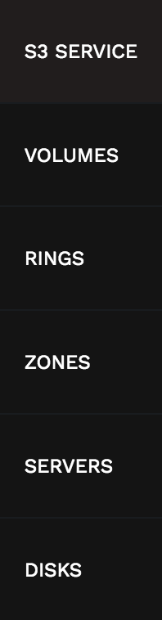
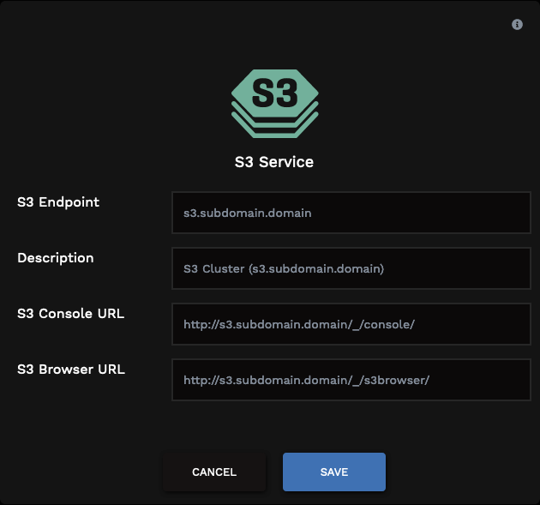
S3C Service Configuration
Make sure that the hostname used is the S3 Endpoint and is DNS-resolvable.

Slide 10

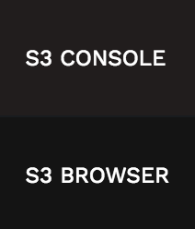
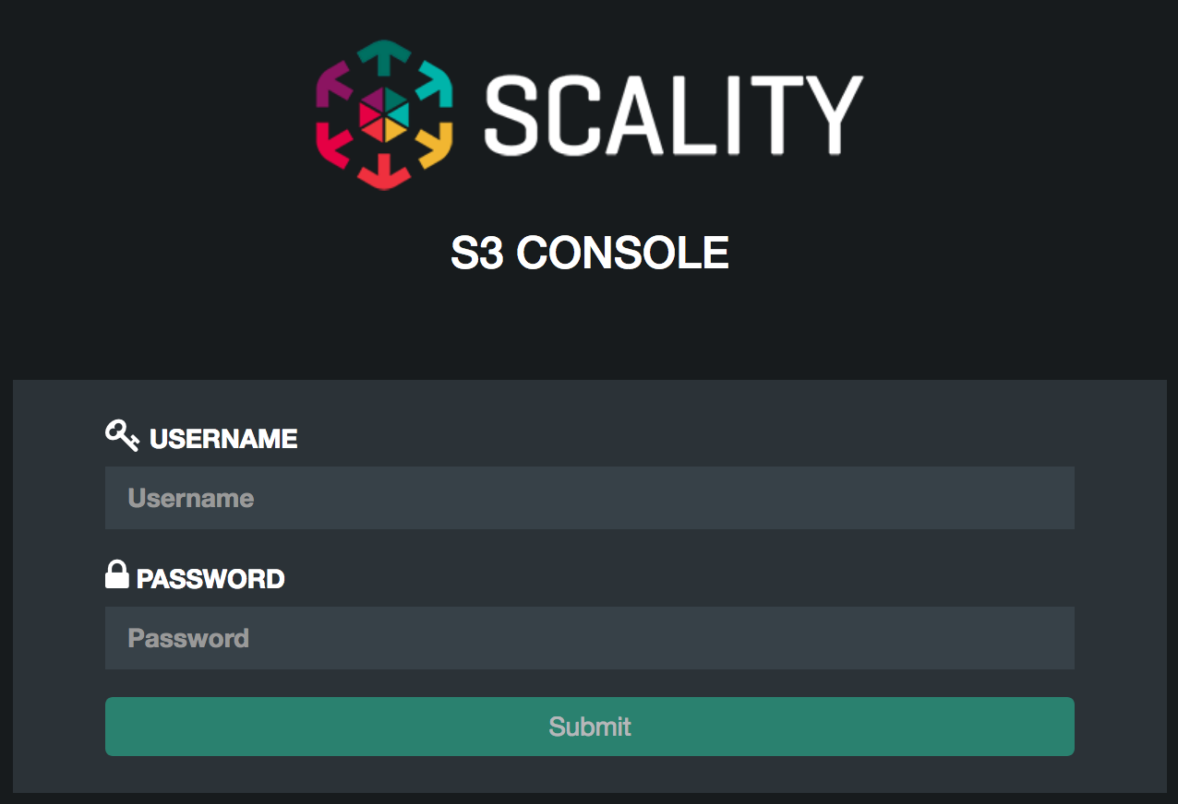
The S3C Console
Super Admin credentials: same as Supervisor Web GUI.

Slide 11
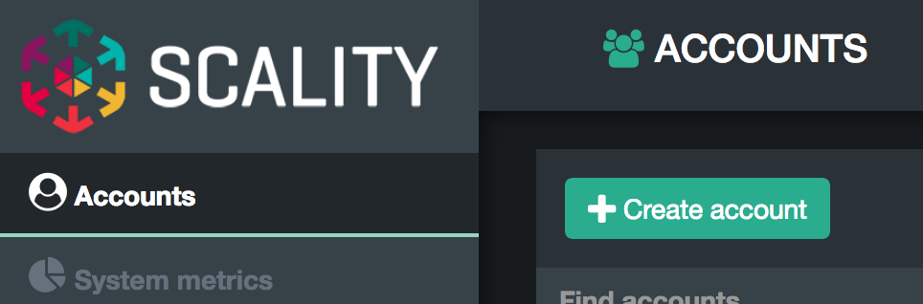
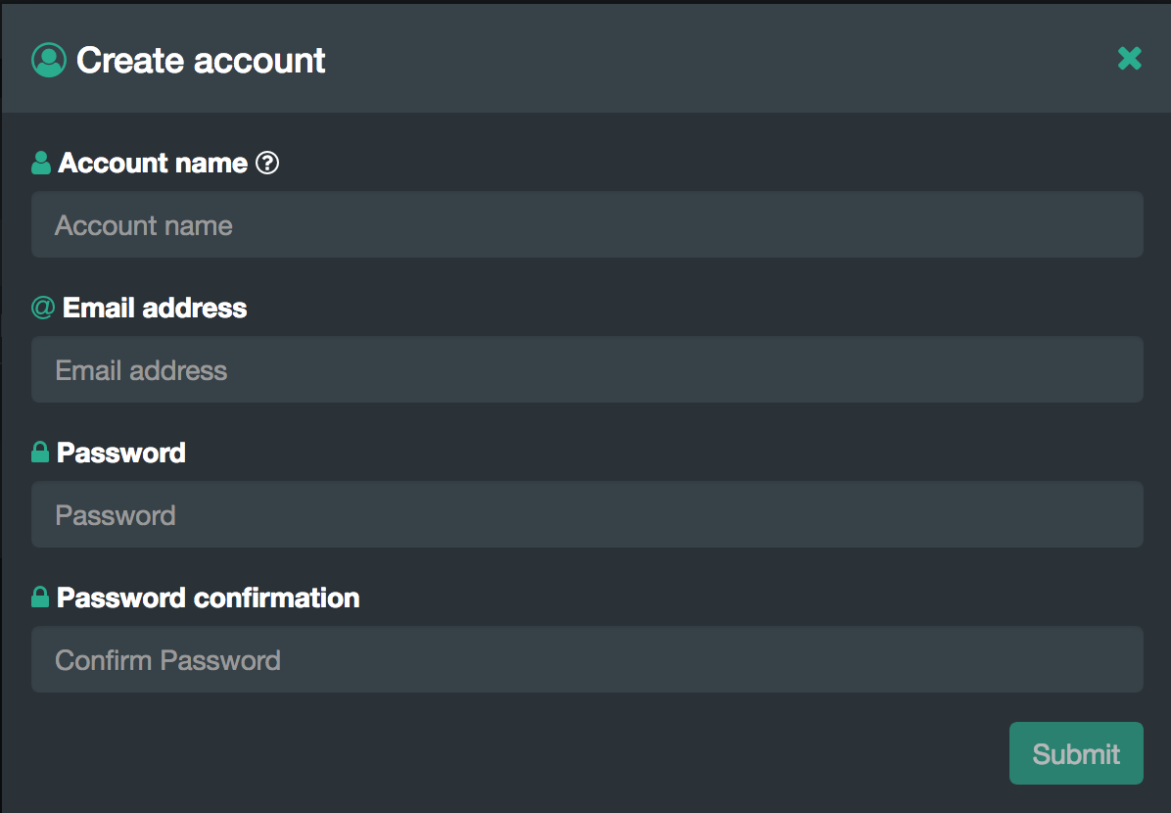
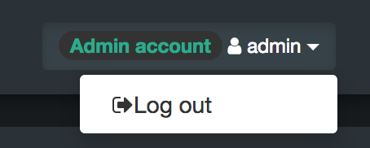
Create an S3C IAM Account (Demo)
Log in the S3 Console as the Super Admin.
2.
3.
Log out.

Slide 12
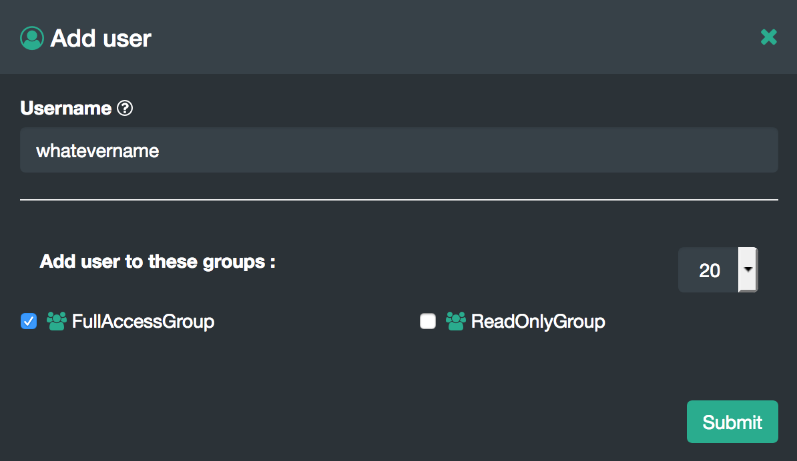
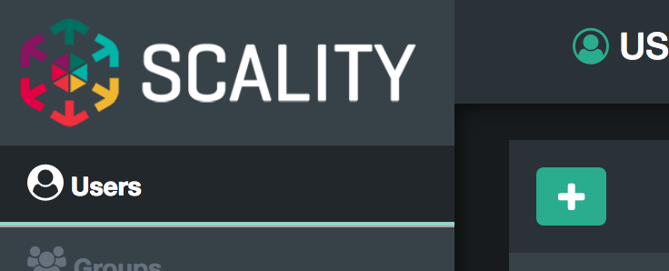
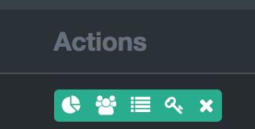
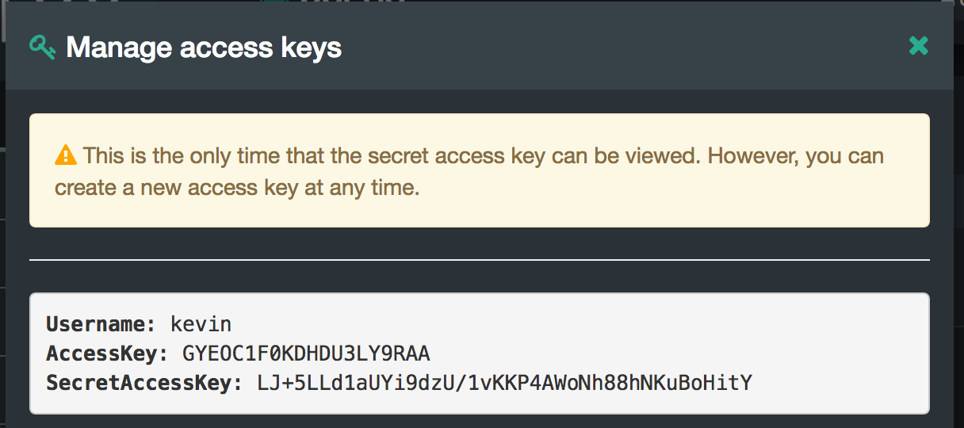
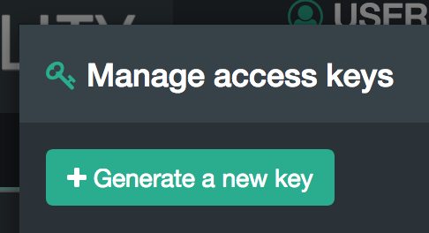
Create an S3C IAM User (Demo)
Log in the S3 Console using the S3C Account credentials previously created.
Done.
Two groups FullAccessGroup and ReadOnlyGroup have been pre-created and are available for quick use.
2.
3.
4.
5.
6.

Slide 13
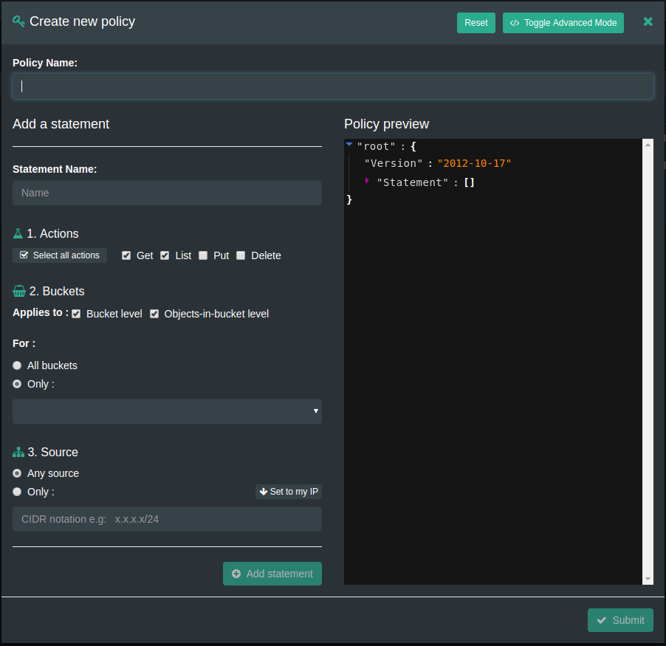
Create an S3C IAM Policy
Two policies FullAccessPolicy and ReadOnlyPolicy have been pre-created and are available for quick use.
Policies written in AWS IAM allow fine permissions granularity.
Sub-management policies permit an account to manage users inside a group and assign specific policies.
To create a policy:
Click Policies to open the Policies window.
Click the New policy button to open the Create new policy window.
Enter the name of the policy.
Add new statements by choosing the desired permissions*.
Click Submit.
(*) For a complete list of supported actions, look up “Actions Supported in IAM Policies” in the Scality S3 Connector Reference guide found on 🔗https://documentation.scality.com.

Slide 14
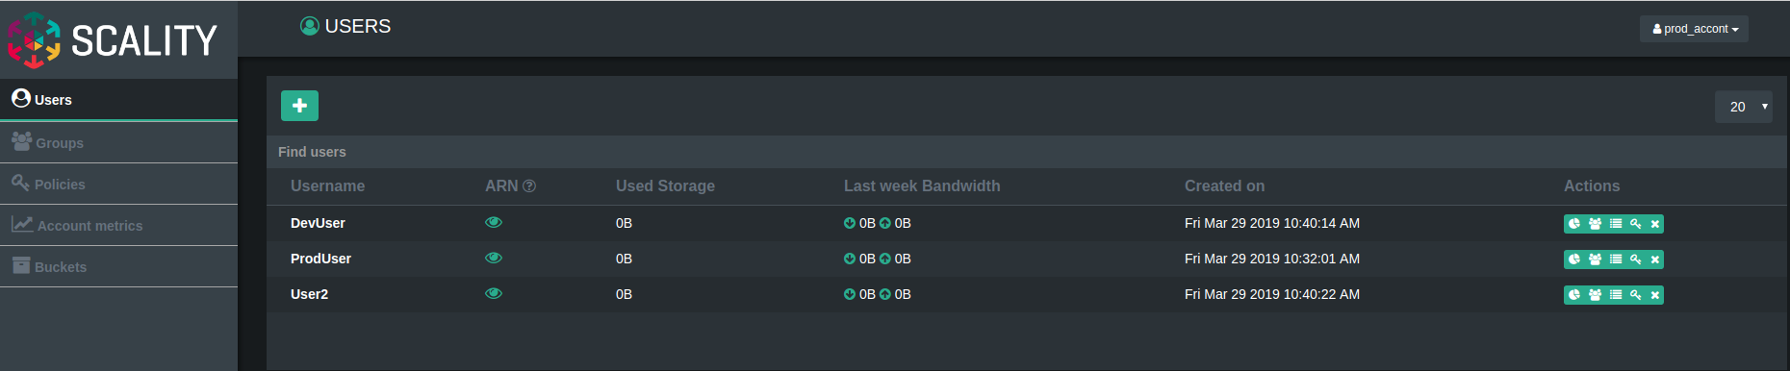
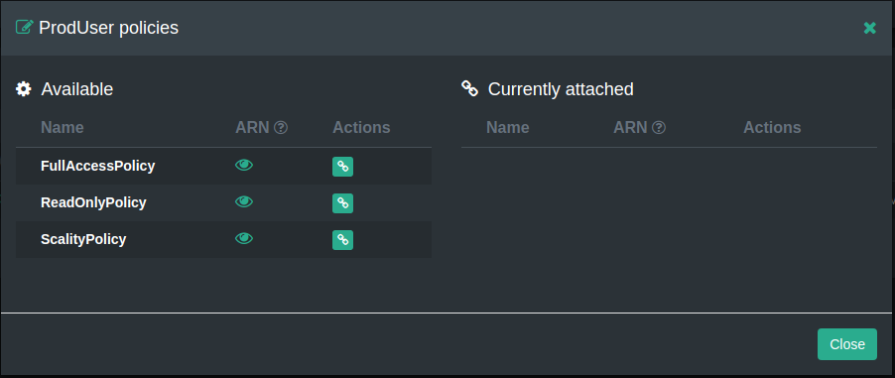
Attach a Policy to an IAM User
Click on Users. The list of IAM users appears.
Click the name of the user to be modified.
Click the Manage <user> policies action button.
Click the Attach policy Action button of the policy to be attached.
Click Close.

Slide 15
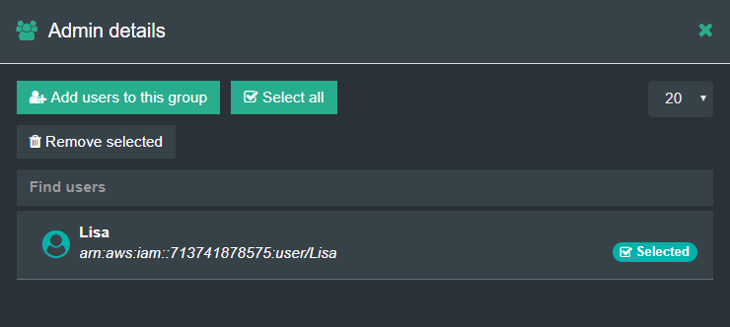
Create an S3C IAM Group
On the Groups Management page, click Create new group.
Enter a name in the Group name field.
Click Submit. The new group displays in the list.
Adding Users to Groups from the S3 Console
Click the group name to view group details and to add users to the group.
Click Add users to this group.
Click to select one of the users or click Select all to select all users.
Click Proceed to add the user(s) to the group.
To remove a user, select the user in the group details window and click Remove selected.
Two groups FullAccessGroup and ReadOnlyGroup have been pre-created and are available for quick use.

Slide 16
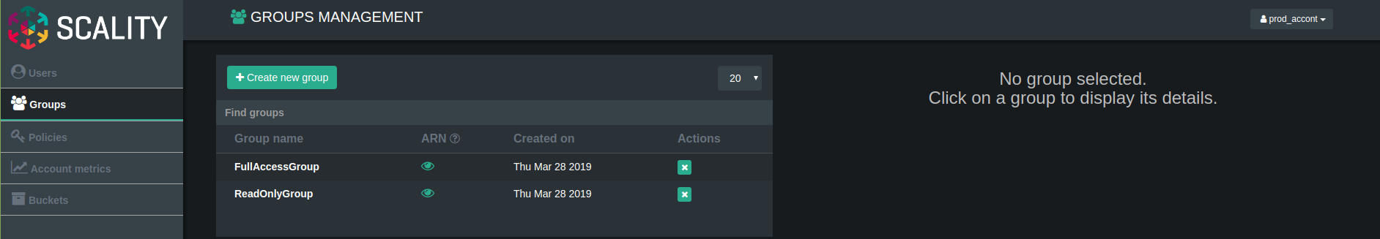
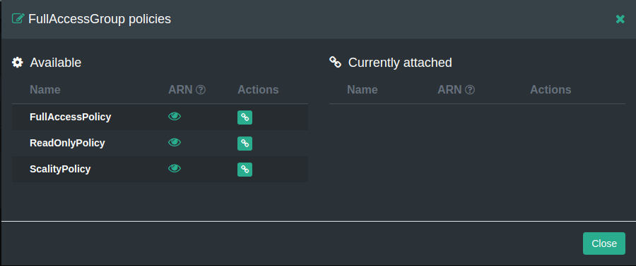
Attach a Policy to an IAM Group
Click on Groups. The list of IAM groups appears.
Click the name of the group to be modified.
Click the Manage group policies button.
Click the Attach policy Action button of the policy to be attached.
Click Close.

Slide 17
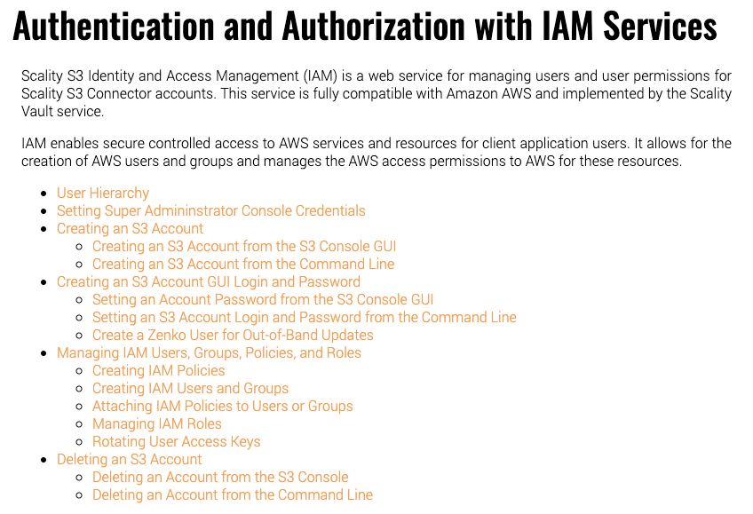
Documentation
Look up “Authentication and Authorization with IAM Services” in the Scality S3 Connector Operations guide found on 🔗https://documentation.scality.com.

Slide 18

S3C Access Management
From the CLI

Slide 19
Create an S3C IAM Account
SSH to the Supervisor.
Change directory to Federation:
Using the Ansible Playbooks, create the IAM account and generate its keys*:
↪ Look for the following in the output:
For more information, look up “Creating an S3 Account from the Command Line” in the Scality S3 Connector Operation guide found on 🔗https://documentation.scality.com.
cd /srv/scality/s3/s3-offline/federation
./ansible-playbook -i env/<deployment_env>/inventory tooling-playbooks/generate-account-access-key.yml -e 'account_name=<account_name> account_email=<email_address> ui_username=<account_name> ui_password=<ui_account_password> container_name_suffix=""'
TASK [/srv/scality/s3/s3-offline/federation/tooling-playbooks/roles/prov/create-account-access-key : AWS access credentials ] #### /!\ ################ IMPORTANT ################### /!\ ####
Here is your AWS credentials, please copy them somewhere secure,
as they will not be persisted to disk:
AWS_ACCESS_KEY_ID = 5W0919IPIT4SS8CVW17H
AWS_SECRET_ACCESS_KEY = vWdWHNJeaGSoqQ7nu3aCDRwuk2M16YcfF0JT4cxH
#### /!\ ################ IMPORTANT ################### /!\ ####
Notes:
(*) For consistency and to avoid confusions, make sure account_name=ui_username

Slide 20
TIP: Set up aliases for AWS CLI Commands
Required only once
SSH to the Supervisor.
Set up your S3 endpoint FQDN (without “http://”) and the aws command path for an easier substitution:
Add the aliases to ~/.bashrc : → if SSL is enabled, replace the last alias with:
Start using the aliases:
S3_ENDPOINT=<s3_endpoint_fqdn>
AWS=/srv/scality/s3/s3-offline/venv/bin/aws
cat <<EOF>> ~/.bashrc
# AWS CLI aliases for convenience
alias aws=${AWS}
alias aws-iam='${AWS} --endpoint-url=http://${S3_ENDPOINT}:8600 iam'
alias aws-s3='${AWS} --endpoint-url=http://${S3_ENDPOINT} s3'
EOF
alias aws-s3='${AWS} --endpoint-url=https://${S3_ENDPOINT} --ca-bundle /etc/ssl/certs/<my_ca_cert>.pem s3'
source ~/.bashrc

Slide 21
How to Set up an AWS IAM Profile
To simplify the use of AWS CLI commands
Set up a profile name for an easier substitution:
Configure the AWS CLI and profile: ↪ This creates two files and their parent directory ~/.aws/config and ~/.aws/credentials.
Test the credentials and configuration:
With an S3C IAM Account profile (listing IAM users):
With an S3C IAM User profile (listing the user’s buckets):
PROFILE_NAME=<profile_name>
aws configure set profile.${PROFILE_NAME}.aws_access_key_id <ACCOUNT_AWS_ACCESS_KEY_ID>
aws configure set profile.${PROFILE_NAME}.aws_secret_access_key <ACCOUNT_AWS_SECRET_ACCESS_KEY>
aws configure set profile.${PROFILE_NAME}.region us-east-1
aws-iam --profile ${PROFILE_NAME} list-users
aws-s3 --profile ${PROFILE_NAME} ls
Notes:
(*) For consistency and to avoid confusions, make sure profile_name=account_name=ui_username for an account profile; and profile_name=user_name for an user profile

Slide 22
Create an S3C IAM Policy (1)
NOTE: Two policies FullAccessPolicy and ReadOnlyPolicy are automatically created by the S3 Console when logging in the Web UI as the account.
Creating a document with the policy statements
As a good practice, create a directory to store the policy documents:
Create a JSON document with the policy’s statements. Example with a full-access policy:
For a complete list of supported Actions, look up “Actions Supported in IAM Policies” in the Scality S3 Connector Reference guide found on 🔗https://documentation.scality.com.
mkdir ~/s3c-policies
cat << EOF > ~/s3c-policies/full-access-policy.json
{
"Version": "2012-10-17",
"Statement": [
{
"Sid": "AllowAll",
"Effect": "Allow",
"Action": "s3:*",
"Resource": "*"
}
]
}
EOF

Slide 23
Create an S3C IAM Policy (2)
Creating the IAM policy
Create the IAM policy from the document:
↪ Retrieve the arn from the output, it will be needed to attach the policy:
To list the policies and their arn’s:
To update an existing policy, see 🔗Editing IAM Policies.
aws-iam --profile ${PROFILE_NAME} create-policy --policy-name FullAccessPolicy --policy-document file:///<linux_user_home>/s3c-policies/full-access-policy.json
{
"Policy": {
"PolicyName": "all-access",
"CreateDate": "2020-07-02T18:05:42Z",
"AttachmentCount": 0,
"IsAttachable": true,
"PolicyId": "8R45V1OAJ5LGGVJ00VUFNVU387NEVXXF",
"DefaultVersionId": "v1",
"Path": "/",
"Arn": "arn:aws:iam::628840374554:policy/FullAccessPolicy",
"UpdateDate": "2020-07-02T18:05:42Z"
}
}
ARN = 🔗Amazon Resource Name
aws-iam --profile ${PROFILE_NAME} list-policies

Slide 24
Create an S3C IAM Group
NOTE: Two groups FullAccessGroup and ReadOnlyGroup are automatically created by the S3 Console when logging in the Web UI as the account.
Create the Group: ↪ Output:
Show group members:
aws-iam --profile ${PROFILE_NAME} create-group --group-name <group_name>
{
"Group": {
"Path": "/",
"CreateDate": "2020-07-02T18:27:11Z",
"GroupId": "XOZKS77JRZ1LRX4IDPJ1DWQVXRSWYBMN",
"Arn": "arn:aws:iam::628840374554:group/<group_name>",
"GroupName": "<group_name>"
}
}
aws-iam --profile ${PROFILE_NAME} get-group --group-name <group_name>

Slide 25
Create an S3C IAM User
Create the User:
Generate the User access and secret keys: ↪ Retrieve the keys from the output and communicate them to the user. Eg:
aws-iam --profile ${PROFILE_NAME} create-user --user-name <user_name>
aws-iam --profile ${PROFILE_NAME} create-access-key --user-name <user_name>
{
"AccessKey": {
"UserName": "christian",
"Status": "Active",
"SecretAccessKey": "AQH4vv9FFqbrK5OwnTd09di1OcMtuyxV4OMTufrN",
"AccessKeyId": "Z0A92AVS2UPXZB3T9P3O"
}
}

Slide 26
Apply a Policy to a User
You have the choice to either:
Attach an IAM policy directly to a User:
Or
Apply an IAM policy to a User as a member of a Group:
Add the user to the group:
Attach the IAM policy to the group
aws-iam --profile ${PROFILE_NAME} attach-user-policy --user-name <user_name> --policy-arn <arn>
aws-iam --profile ${PROFILE_NAME} add-user-to-group --group-name <group_name> --user-name <user_name>
aws-iam --profile ${PROFILE_NAME} attach-group-policy --group-name <group_name> --policy-arn <arn>

Slide 27
Documentation
Look up “Authentication and Authorization with IAM Services” in the Scality S3 Connector Operations guide found on 🔗https://documentation.scality.com.

Slide 28
S3C Quotas

Slide 29
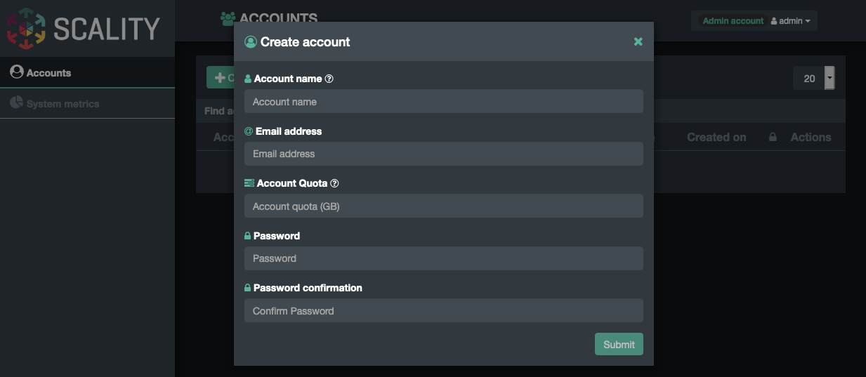
S3C Quotas
When handled via the S3 Console
Quotas are set at the account level:
Notes:
RING8

Slide 30
S3C Quotas
When handled via CLI (VaultClient)
Example:
➥ Output:
vaultclient create-account --name <account name> --email <email address> --quota <*n* bytes>
vaultclient create-account --name test --email account@test.com --quota 1000000
{
"account": {
"arn": "arn:aws:iam::425387641315:/test/",
"canonicalId": "3bde038ab73eb0e04a30ae7a6a5c9593314ada35e29f7b2f7761fdb9082d99e9",
"id": "425387641315",
"emailAddress": "test@test.com",
"name": "test",
"createDate": "2019-02-26T19:08:02Z",
"aliasList": [],
"oidcpList": [],
"quotaMax": 1000000
}
}

Slide 31
S3C Bucket Versioning

Slide 32
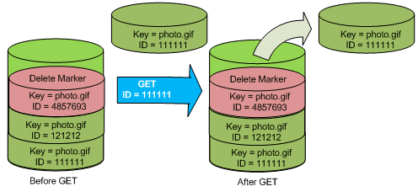
S3C Bucket Versioning
The S3 Connector implements the Bucket Versioning API
PUT Bucket Versioning creates a versioned Bucket.
This enables the Bucket to maintain object versions.
If an object with the same key is PUT, it becomes the current version.
If an object with the same key is DELETED, a DELETE marker is used to indicate current version deleted.
Preserves object key for current version, but maintains separate IDs for older versions.
Enables Data Restoration
Access to previous states/versions of an object (GET object with specified version ID).
Basic WORM
Immutable data – objects never overwritten with versioning.
Use IAM Policies to disable deletes of versioned objects.
Available through AWS CLI only.

Slide 33
create a versioned bucket
creating the bucket:
put object “test” with data “test1” into bucket without versioning:
enable bucket versioning on the bucket:
verify that bucket versioning is enabled on the bucket:
the Output should show that bucket versioning is enabled on the bucket:
aws s3api create-bucket --bucket verbucket http://localhost:8000
aws s3api put-object --bucket verbucket http://localhost:8000 --key test --body test1
aws s3api put-bucket-versioning --bucket verbucket --versioning-configuration Status=Enabled http://localhost:8000
aws s3api get-bucket-versioning --bucket verbucket http://localhost:8000
: ‚output:
„Status“: „Enabled“

Slide 34
create versioned object copies
put object “test” with data “test2” into (the now versioned) bucket:
the Output shows the versionID of the object:
list the versions of the object:
request the initial “null” version of the object:
Logs are in /var/log/scality-sfused.log.
For more operations procedures and commands for other OS, check out the RING 6.4.3 Operations Guide (4. Operations Procedures) downloadable here: https://docs.scality.com/display/R6/RING+6+Documentation+and+Packages.
aws s3api put-object --bucket verbucket http://localhost:8000 --key test --body test2
{
„VersionId“: „98510238070775999999undef1028“
}
aws s3api list-object-versions --bucket verbucket http://localhost:8000
aws s3api get-object --bucket verbucket --key test --version-id 'null' test http://localhost:8000

Slide 35
handle versioned objects
request a specific version of the object:
the Output shows the versionID of the object:
list the versions of the object:
request the initial “null” version of the object:
Logs are in /var/log/scality-sfused.log.
For more operations procedures and commands for other OS, check out the RING 6.4.3 Operations Guide (4. Operations Procedures) downloadable here: https://docs.scality.com/display/R6/RING+6+Documentation+and+Packages.
aws s3api put-object --bucket verbucket http://localhost:8000 --key test --body test2
{
„VersionId“: „98510238070775999999undef1028“
}
aws s3api list-object-versions --bucket verbucket http://localhost:8000
aws s3api get-object --bucket verbucket --key test --version-id 'null' test http://localhost:8000

Slide 36
S3C Utilization API
S3 7.10

Slide 37
S3C Utilization API
<Text>

Slide 38
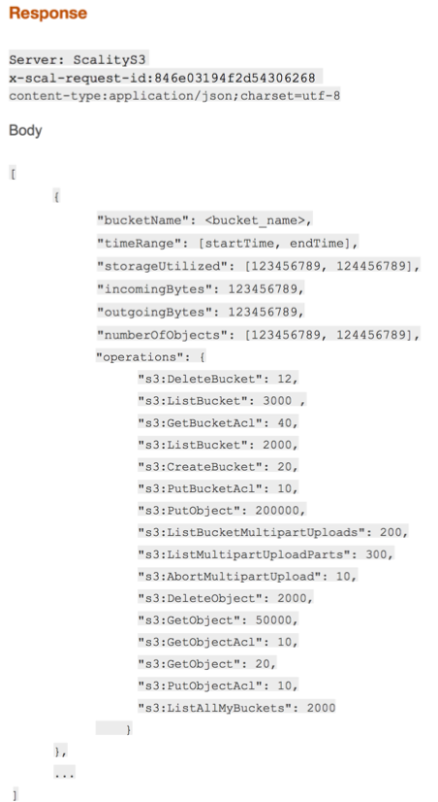
S3C Utilization API (UTAPI)
Utilization REST API for the S3 Connector
System-wide, Account & User level metrics.
Bucket & Service Level.
Detailed Utilization Metrics
Storage capacity and number of objects
Input/output bandwidth (bytes transferred) per unit time
# of S3 operations (PUT, GET, DELETE, HEAD, MPU, ACLs) per unit time
Accessible via RESTful POST commands
JSON input parameters & responses
Integrated with its own IAM Policies for access control

Slide 39
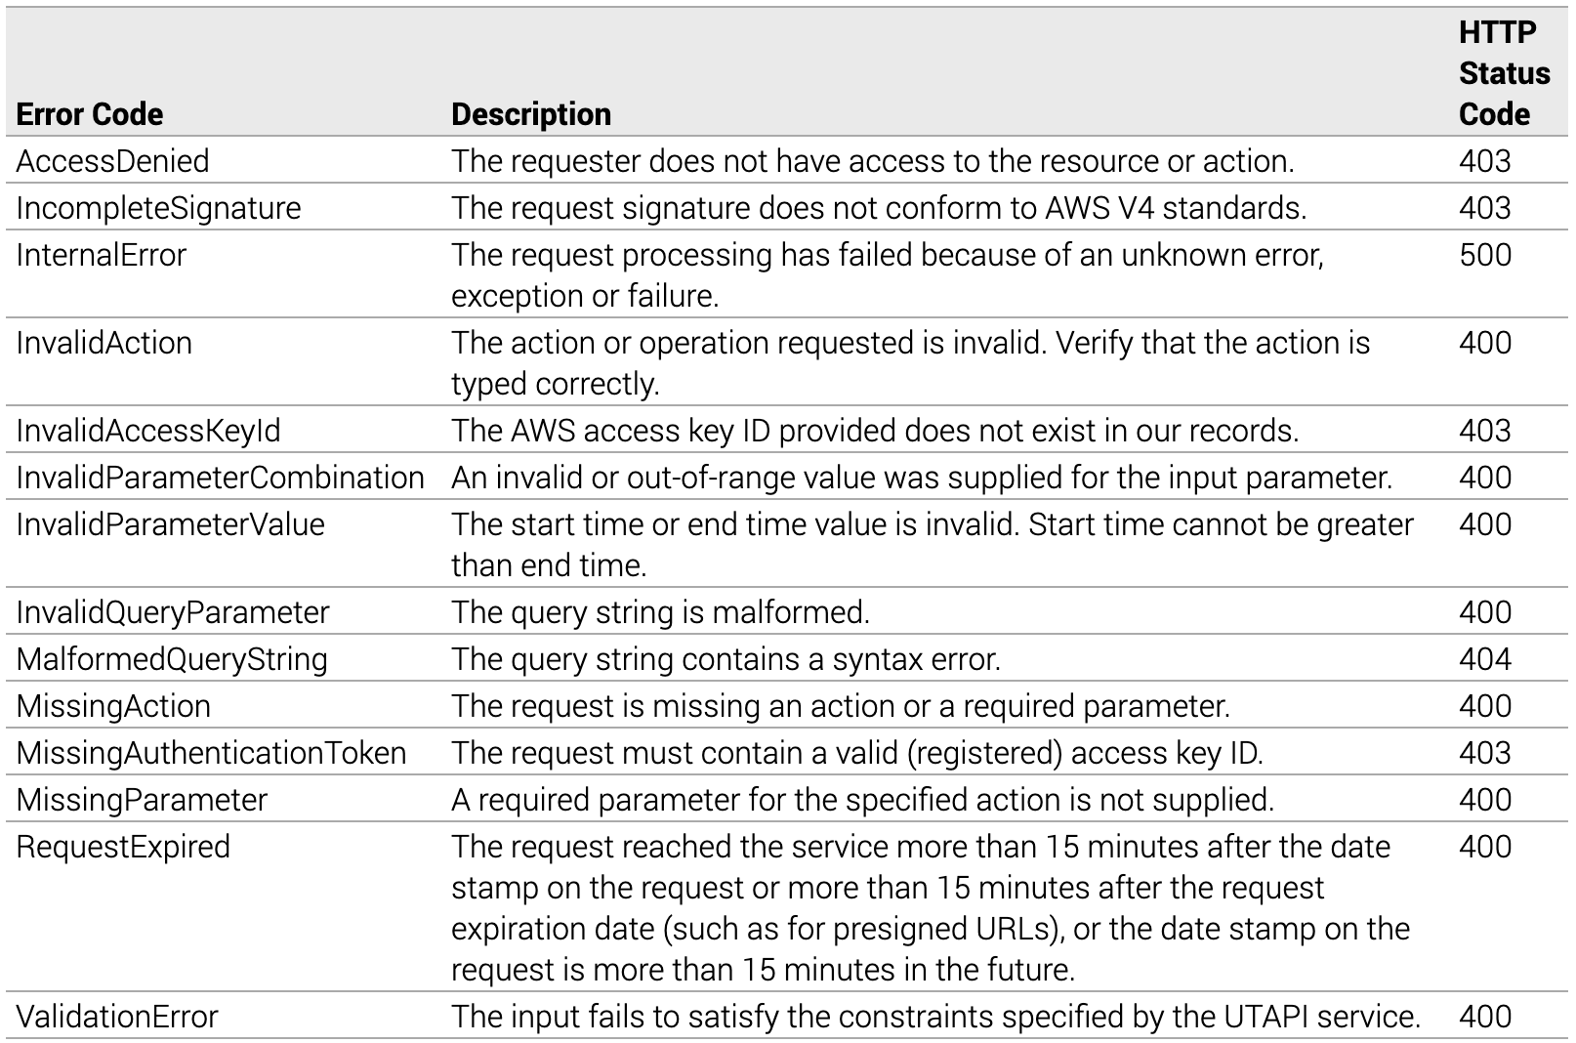
UTAPI Error Codes

Slide 40
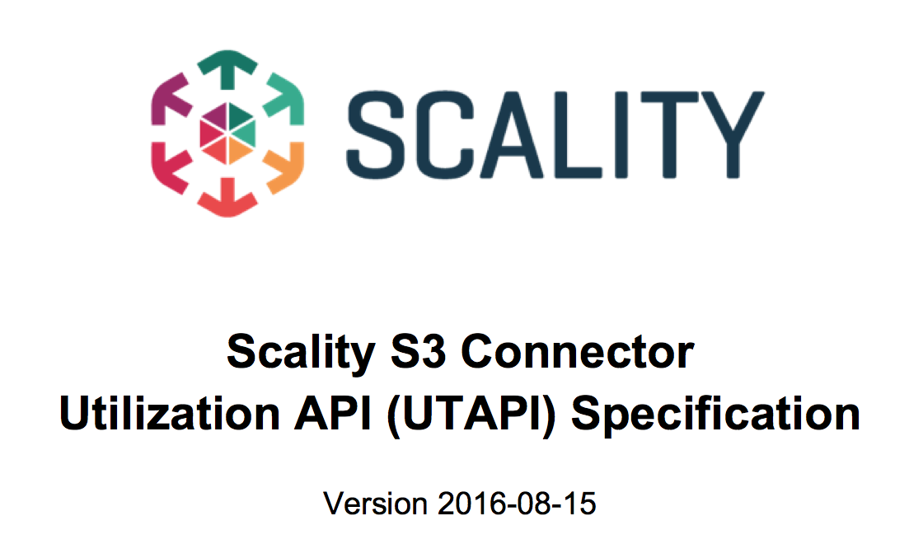
S3 Utilization API (UTAPI)
S3 Connector Utilization REST API for the S3 Connector
Bucket and Account level metrics in R6.4.0
User & Service Level metrics in 7.0
Detailed Utilization Metrics
Storage capacity and number of objects
Input/output bandwidth (bytes transferred) per unit time
# of S3 operations (PUT, GET, DELETE, HEAD, MPU, ACLs) – per unit time
Accessible via RESTful POST commands
JSON input parameters & responses
Integrated with its own IAM Policies for access control

Slide 41
create an IAM user for UTAPI
create an IAM user:
create the access and secret keys for the user:
create an IAM policy for the user to use UTAPI:
aws iam create-user –user-name utapiuser
aws iam create-access-key –user-name utapiuser
cat - > utapipolicy.json <<;EOF { "Version": "2012-10-17", "Statement": [
{ "Sid": "utapiMetrics", "Action": [ "utapi:ListMetrics" ], "Effect": "Allow", "Resource": "arn:scality:utapi:::buckets/*" } ] } EOF

Slide 42
map the UTAPI policy and test
create the UTAPI policy:
attach the UTAPI policy to the utapiuser:
execute bash withing the S3 container to test UTAPI:
test the UTAPI functionality with nodejs, a typical call would look like this:
Logs are in /var/log/scality-sfused.log.
For more operations procedures and commands for other OS, check out the RING 6.4.3 Operations Guide (4. Operations Procedures) downloadable here: https://docs.scality.com/display/R6/RING+6+Documentation+and+Packages.
aws iam create-policy --policy-name utapipolicy --policy-document file://utapipolicy.json
aws iam attach-user-policy --user-name utapiuser --policy-arn <policy arn>
docker exec –ti scality-s3 /bin/bash
node bin/list_ metrics - - metric buckets - - buckets testbucket- - start 1476231300000 --end 1476233099999 -a myAccessKey -k mySecretKey -h 127.0.0.1 -p 8100 --ssl

Slide 43
S3C Data Access Exercise

Slide 44
Exercise
Using the S3 Console:
Create a new Account.
Create a new User from that Account with full rights.
Test the service:
Use the Scality S3 Browser to access the User data.
Create buckets and upload files.

Slide 45
S3C Data Access Exercise from CLI

Slide 46
Exercise
Using AWS CLI:
Create a new Account.
Create a new User from that Account with full rights.
Test the service:
Use the Scality S3 Browser to access the User data.
Create buckets and upload files.

Slide 47
S3C Client Access

Slide 48
Scality S3C API
Compatibility with AWS S3 API
Rich compatibility with S3 API for most use-cases.
Cross-Region Replication (CRR).
Byte Range.
IAM Policy.
Multi Part Upload (MPU).
Meta Data (x-amz-meta) header.
For more information about the compatibility, check out “Supported APIs” in the S3 Connector Reference guide found at 🔗https://documentation.scality.com.

Slide 49
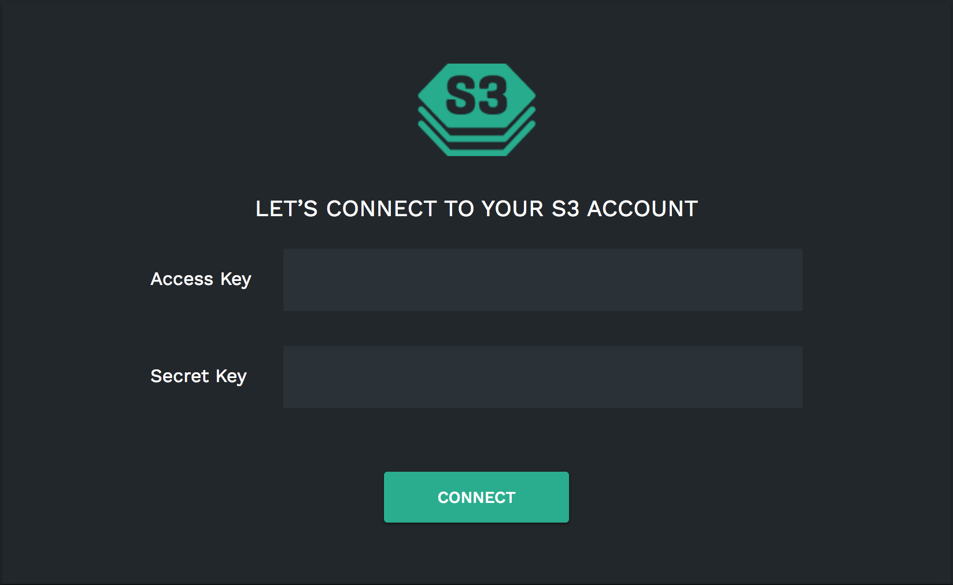

S3C Client Example (Demo)
Tools of the Trade
Scality S3C Browser: http://<S3_endpoint>/_/s3browser/
Some other popular S3 clients
🔗s3cmd.
🔗aws cli.
🔗Cyberduck.
User Access and Secret Keys

Slide 50
Accessing S3: Example with AWS CLI
Requirements:
The S3C endpoint FQDN.
Your Access and Secret Keys (generated by the Account admin).
A client machine, e.g:
here, a VM running CentOS 7.8,
install AWS CLI:
More on 🔗Installing, updating, and uninstalling the AWS CLI.
curl "https://awscli.amazonaws.com/awscli-exe-linux-x86_64.zip" -o "awscliv2.zip"
unzip awscliv2.zip
sudo ./aws/install

Slide 51
TIP: Set up aliases for AWS CLI Commands
Required only once
SSH to the client machine.
Set up your S3 endpoint FQDN (without “http://”) and the aws command path for an easier substitution:
Add the aliases to ~/.bashrc : → if SSL is enabled, replace the last alias with:
Start using the aliases:
S3_ENDPOINT=<s3_endpoint_fqdn>
AWS=/usr/local/bin/aws
cat <<EOF>> ~/.bashrc
# AWS CLI aliases for convenience
alias aws=${AWS}
alias aws-s3='${AWS} --endpoint-url=http://${S3_ENDPOINT} s3'
EOF
alias aws-s3='${AWS} --endpoint-url=https://${S3_ENDPOINT} --ca-bundle /etc/ssl/certs/<my_ca_cert>.pem s3'
source ~/.bashrc

Slide 52
How to Set up an AWS IAM Profile
To simplify the use of AWS CLI commands
Set up a profile name for an easier substitution:
Configure the AWS CLI and profile: ➥ This creates two files and their parent directory ~/.aws/config and ~/.aws/credentials.
Test the credentials and configuration: ➥ Displays the help pages for aws s3.
PROFILE_NAME=<profile_name>
aws configure set profile.${PROFILE_NAME}.aws_access_key_id <ACCOUNT_AWS_ACCESS_KEY_ID>
aws configure set profile.${PROFILE_NAME}.aws_secret_access_key <ACCOUNT_AWS_SECRET_ACCESS_KEY>
aws configure set profile.${PROFILE_NAME}.region us-east-1
aws-s3 --profile ${PROFILE_NAME} help
Notes:
(*) For consistency and to avoid confusions, make sure profile_name=account_name=ui_username for an account profile; and profile_name=user_name for an user profile

Slide 53
Some AWS S3 commands
Create a bucket: ➥ Output:
Upload a file: ➥ Output:
Download an object: ➥ Output:
aws-s3 --profile ${PROFILE_NAME} mb s3://<bucket_name>
make_bucket: <bucket_name>
aws-s3 --profile ${PROFILE_NAME} cp <file_name> s3://<bucket_name>/<file_name>
upload: ..<file_name> to s3://<bucket_name>/<file_name>
aws-s3 --profile ${PROFILE_NAME} cp s3://<bucket_name>/<file_name> .
download: s3://<bucket_name>/<file_name> to ./<file_name>
Notes:
(*) For consistency and to avoid confusions, make sure profile_name=account_name=ui_username for an account profile; and profile_name=user_name for an user profile

Slide 54

QUESTIONS ?

